Slide 1
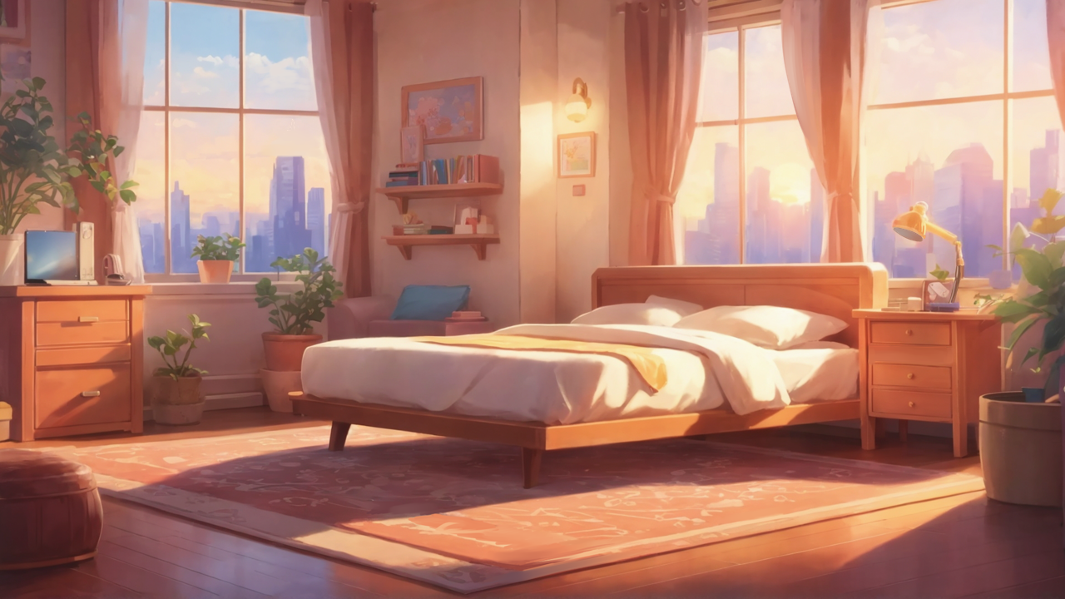

Slide 2

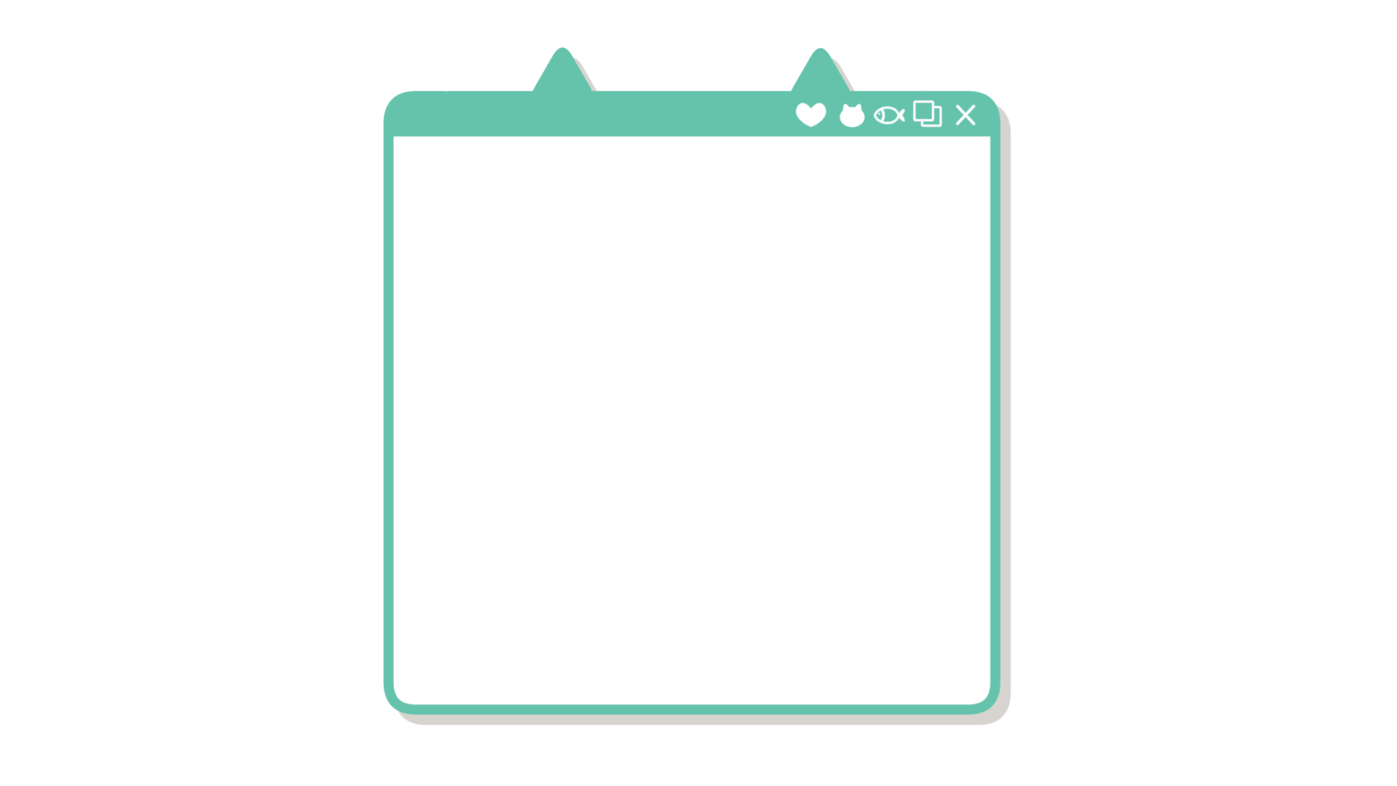
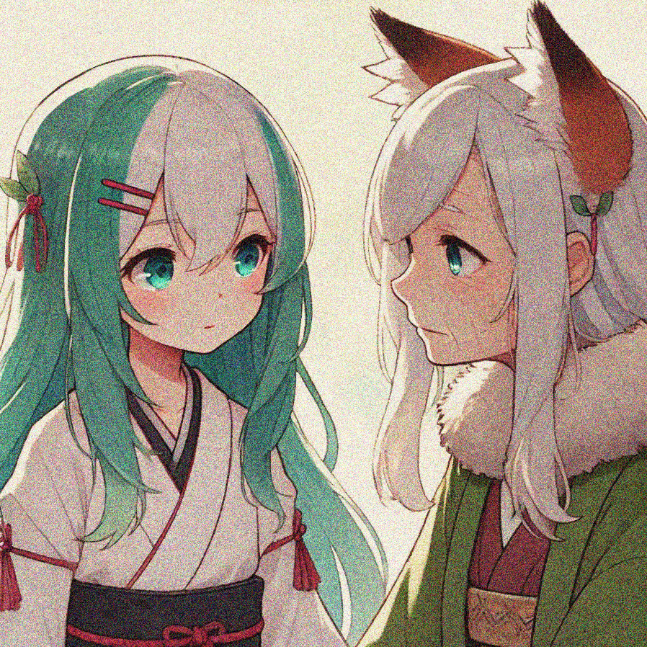
Aim
Notes:
a Japanese anime-style girl with brown hair tied up as two top knot, happily smiling

Slide 3
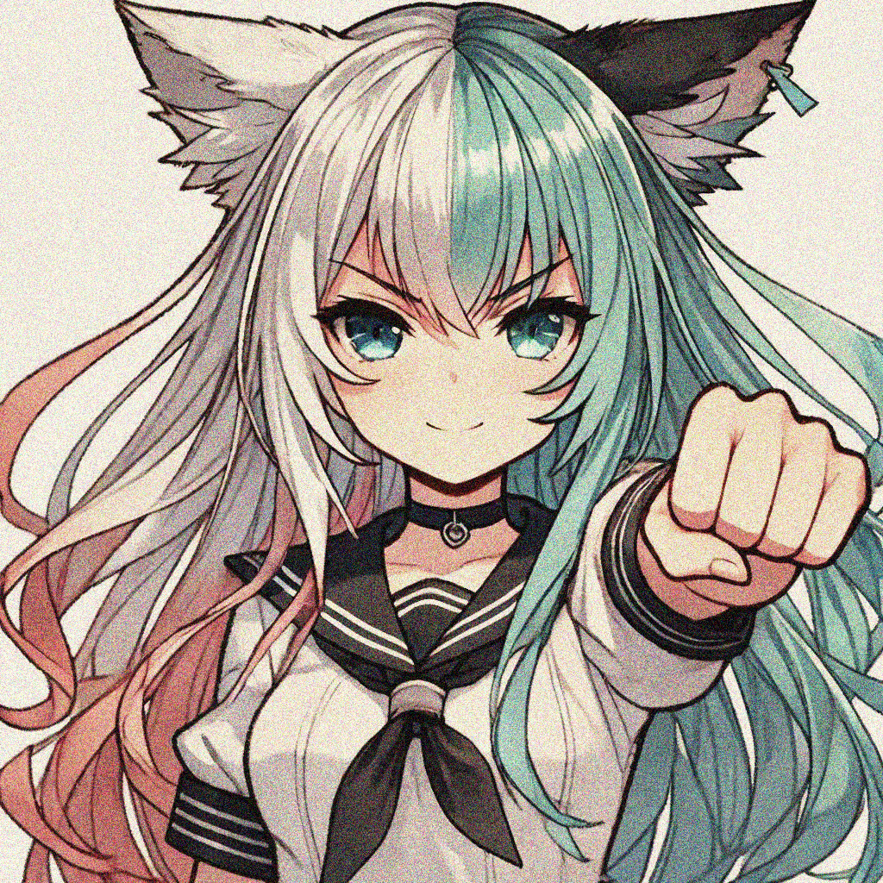
Aim
Notes:
a Japanese anime-style girl with dark brown hair tied up as two top knot,looking at a bulletin board

Slide 4
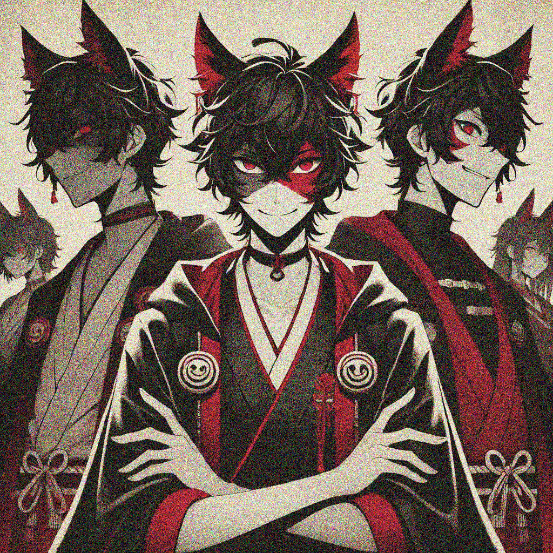
Obstacle
Notes:
a Japanese anime-style girl wearing uniform ,with dark brown hair tied up as two top knot, crying

Slide 5
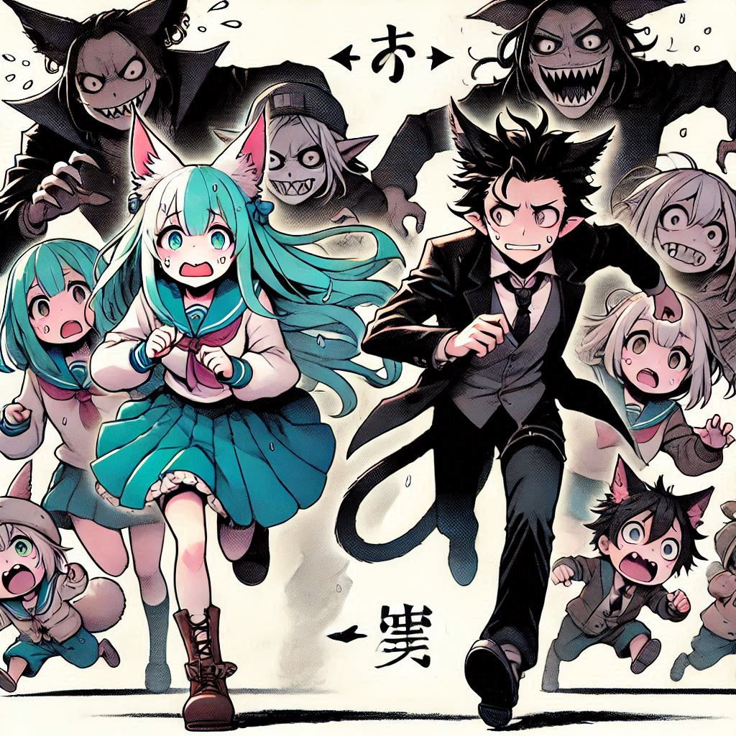
Obstacle
Notes:
a Japanese anime-style girl wearing uniform ,with dark brown hair tied up as two top knot, crying

Slide 6
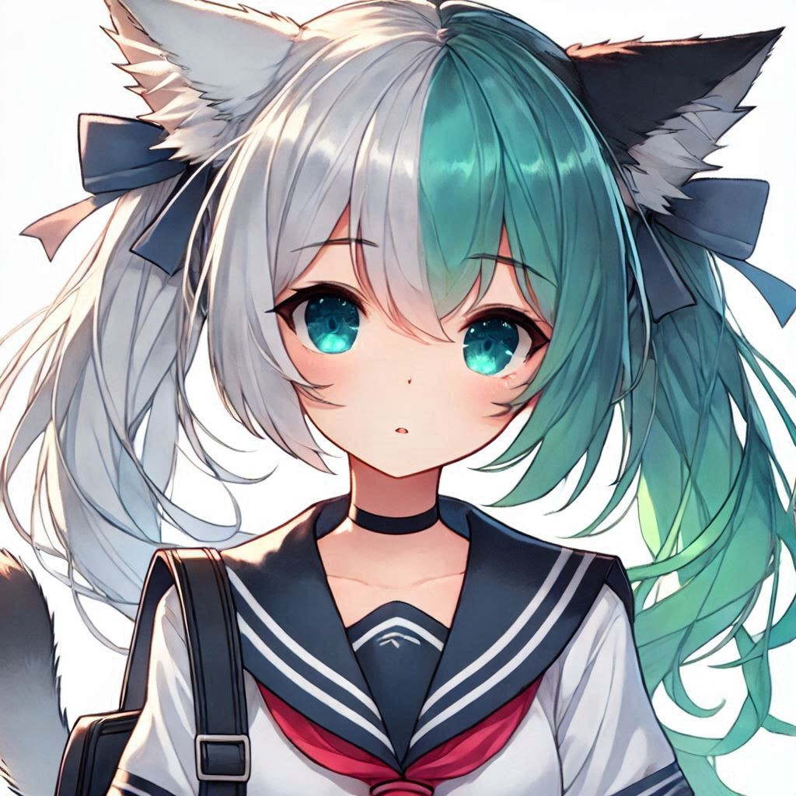
Obstacle
Notes:
a Japanese anime-style girl wearing uniform ,with dark brown hair tied up as two top knot, crying

Slide 7
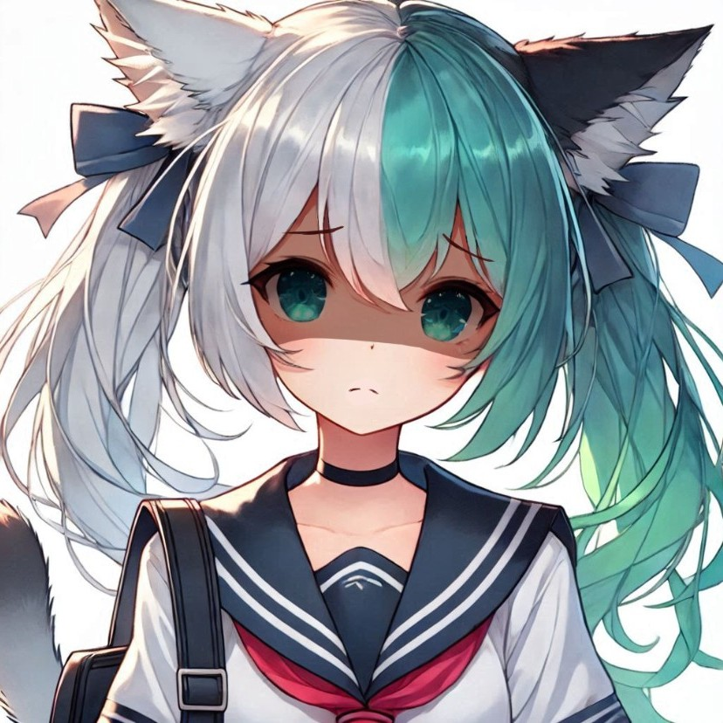
Obstacle
Notes:
自己加工

Slide 8
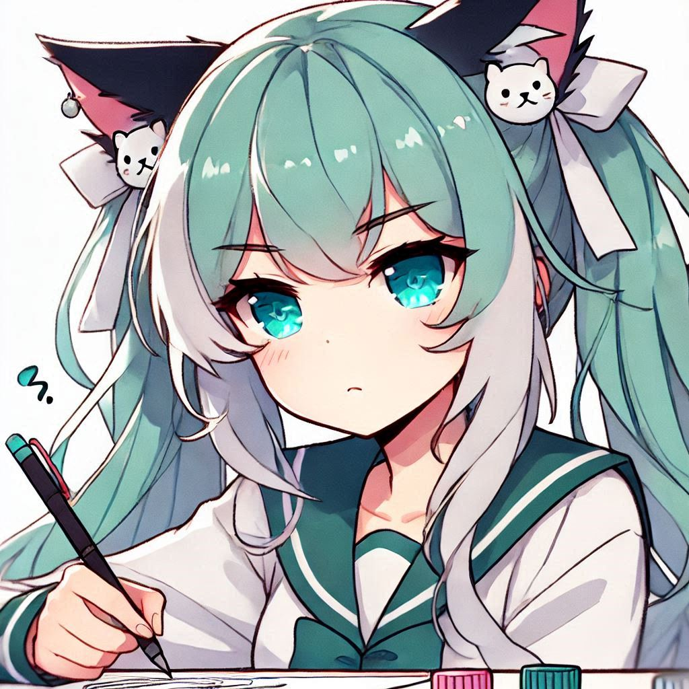
Effort
Notes:
a Japanese anime-style girl with dark brown hair tied up as two top knot, holding tightly onto a painting, looks determined

Slide 9
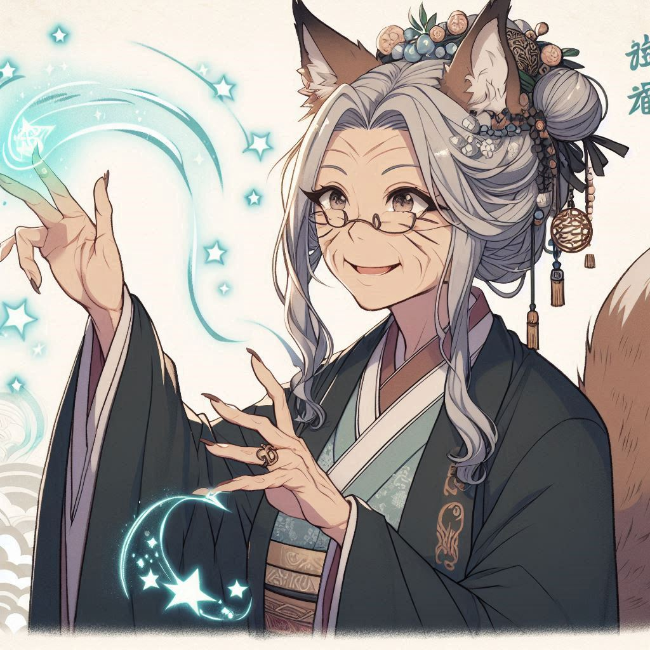
Effort
Notes:
a Japanese anime-style girl with dark brown hair tied up as two top knot, holding a painting and rushing into a venue, panting

Slide 10
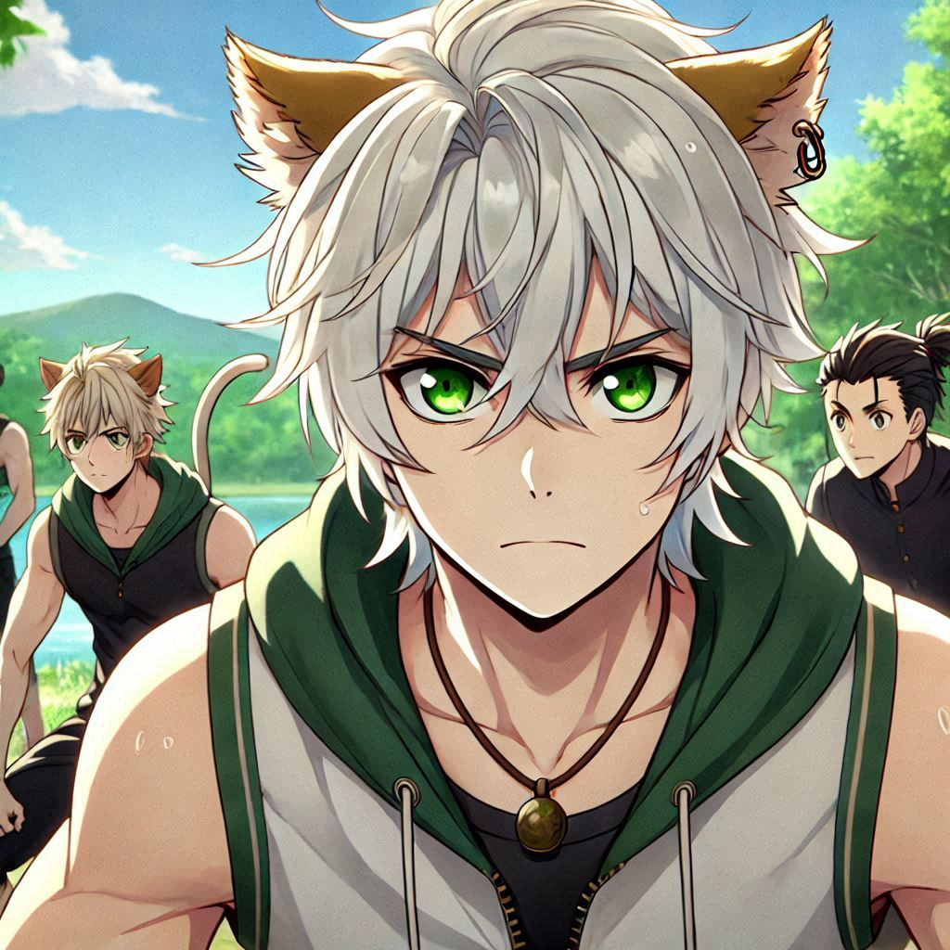
Effort
Notes:
a Japanese anime-style girl with dark brown hair tied up as two top knot, sitting on floor and crying

Slide 11
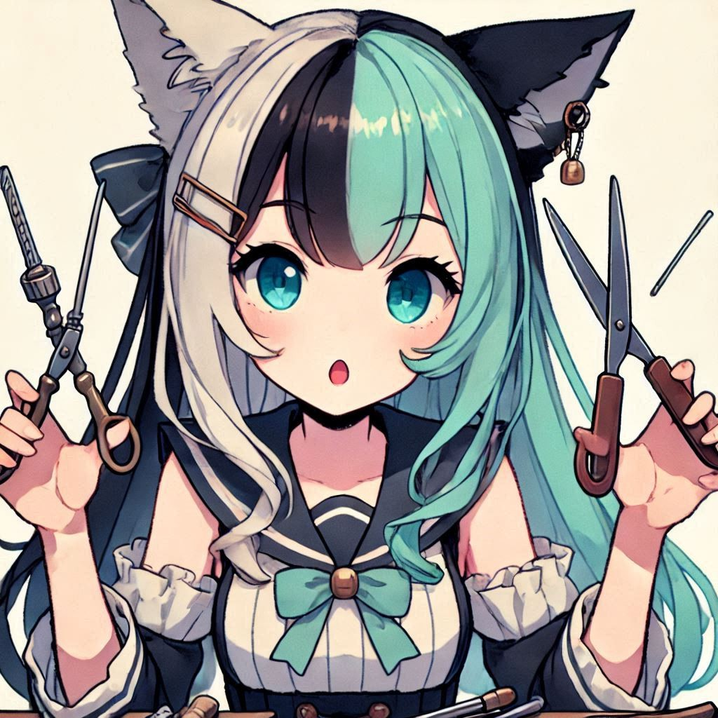
Result
Notes:
a Japanese anime-style girl with dark brown hair tied up in two top knots, lying on floor , too tired to fall asleep

Slide 12
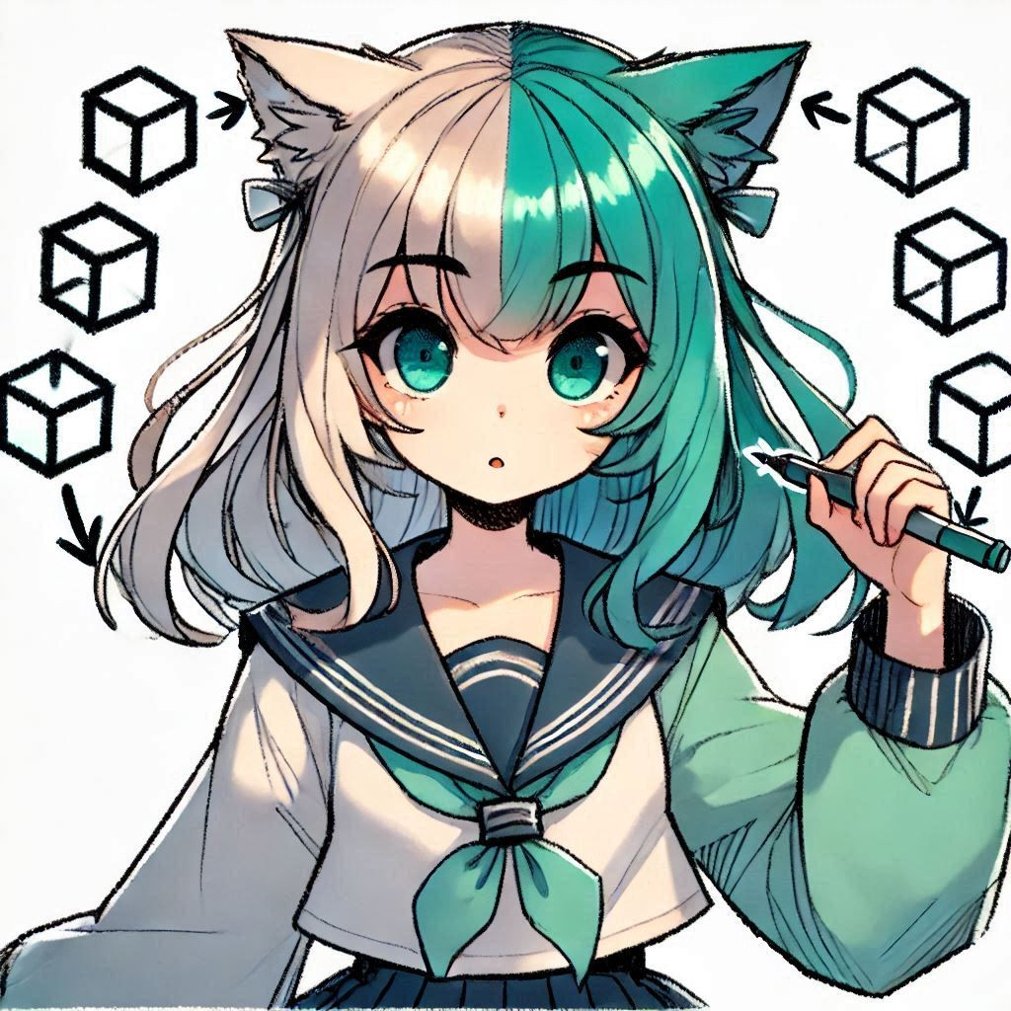
Result
Notes:
自己加工

Slide 13
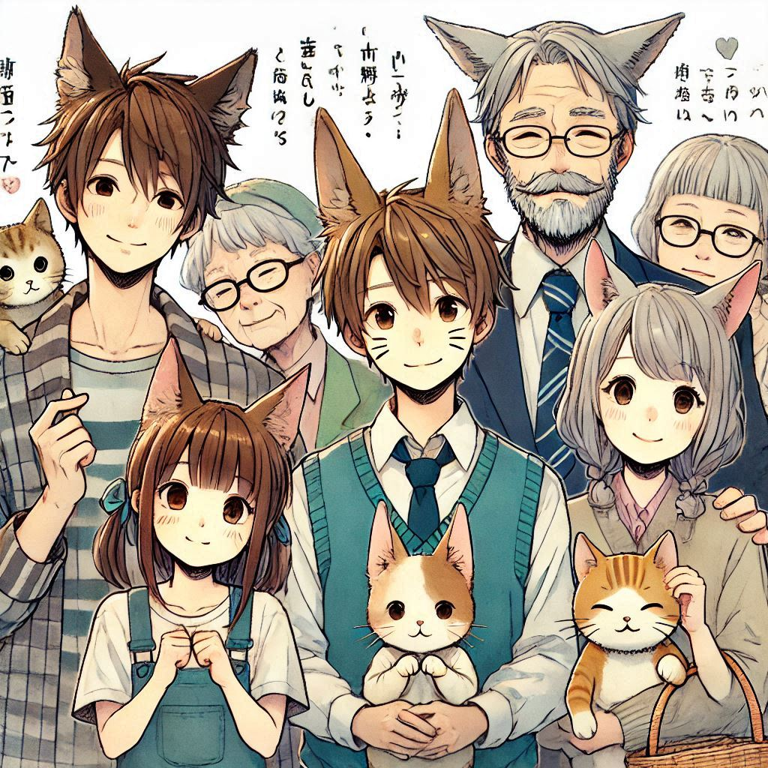
Accident
Notes:
a Japanese anime-style girl with two-toned hair (left side blue-green, right side white), sitting in a forest

Slide 14
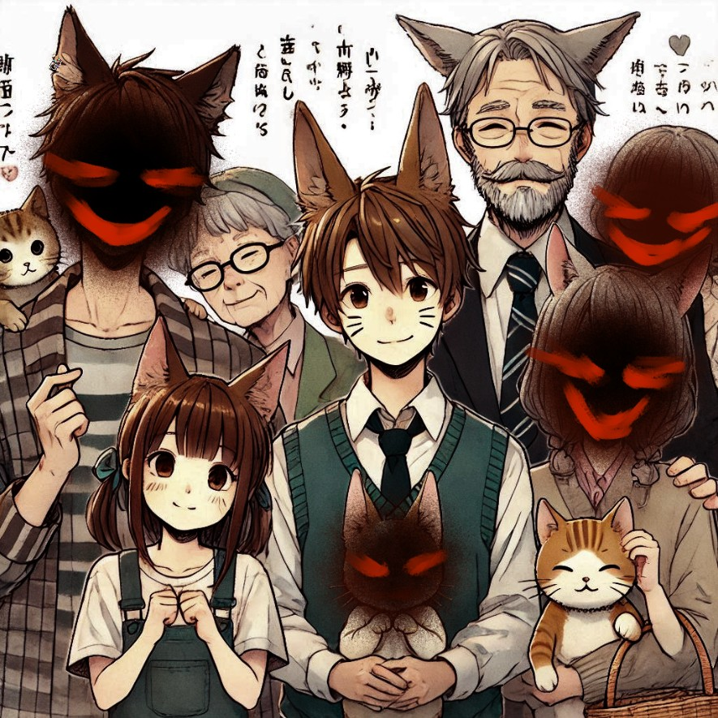
Accident
Notes:
a Japanese anime-style girl with two-toned hair (left side blue-green, right side white), looking at a old woman who has ears of fox

Slide 15
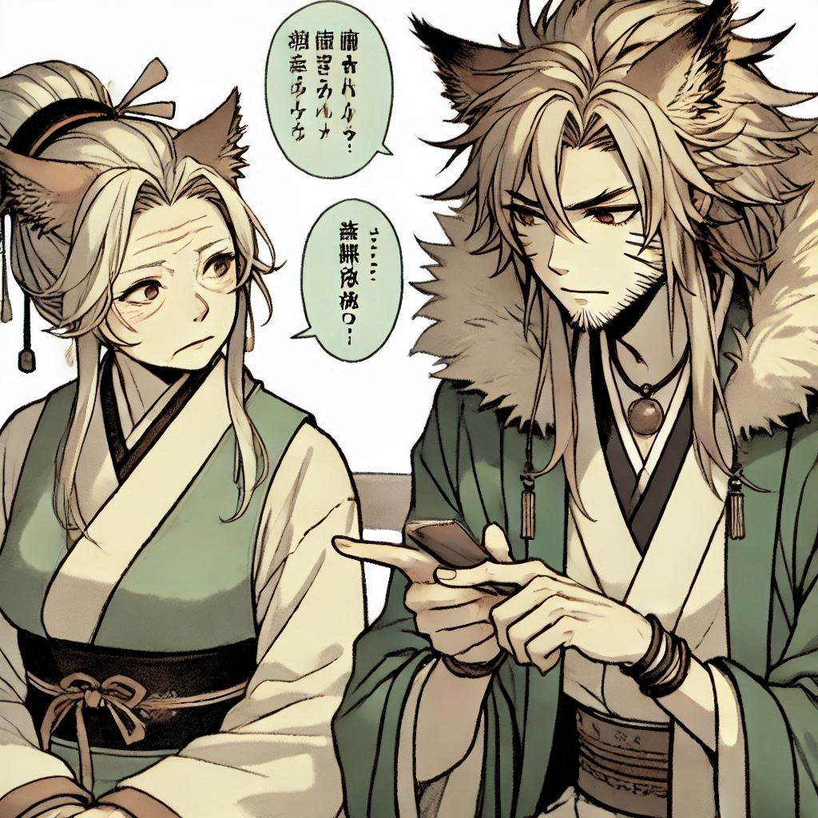
Twist
Notes:
a Japanese anime-style girl with cats ears,having two-toned hair (left side blue-green, right side white)

Slide 16
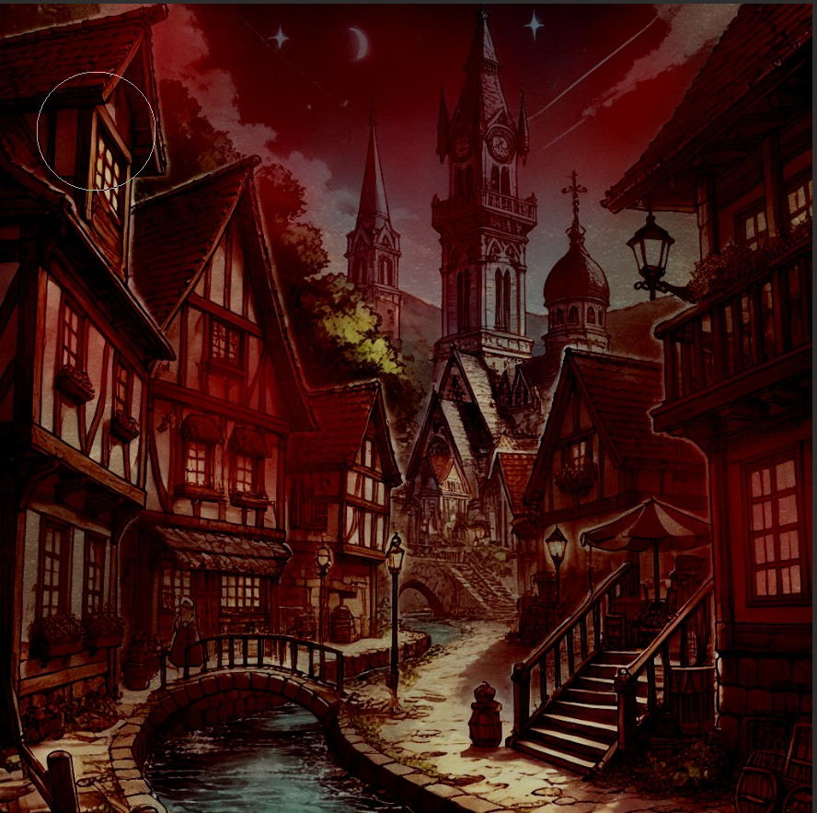
Ending
Notes:
a Japanese anime-style girl with two-toned hair (left side blue-green, right side white)

Slide 17
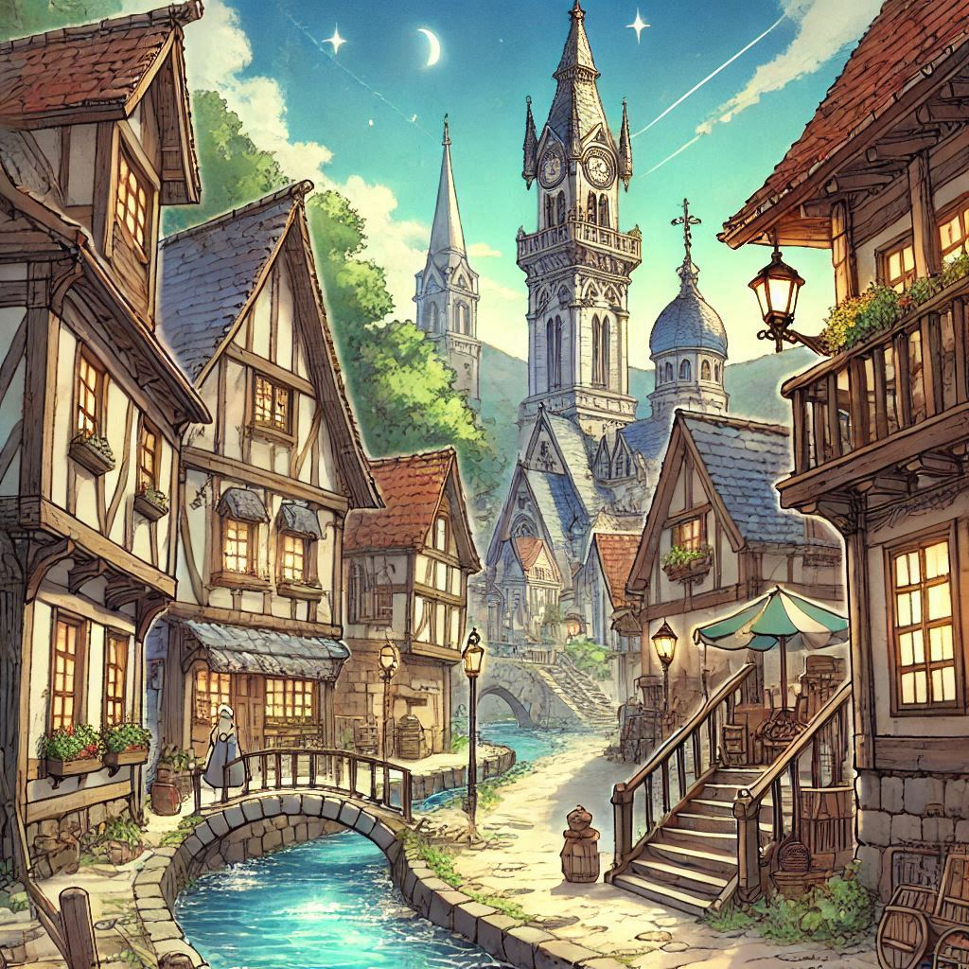
Ending
Notes:
a Japanese anime-style girl with two-toned hair (left side blue-green, right side white)

Slide 18
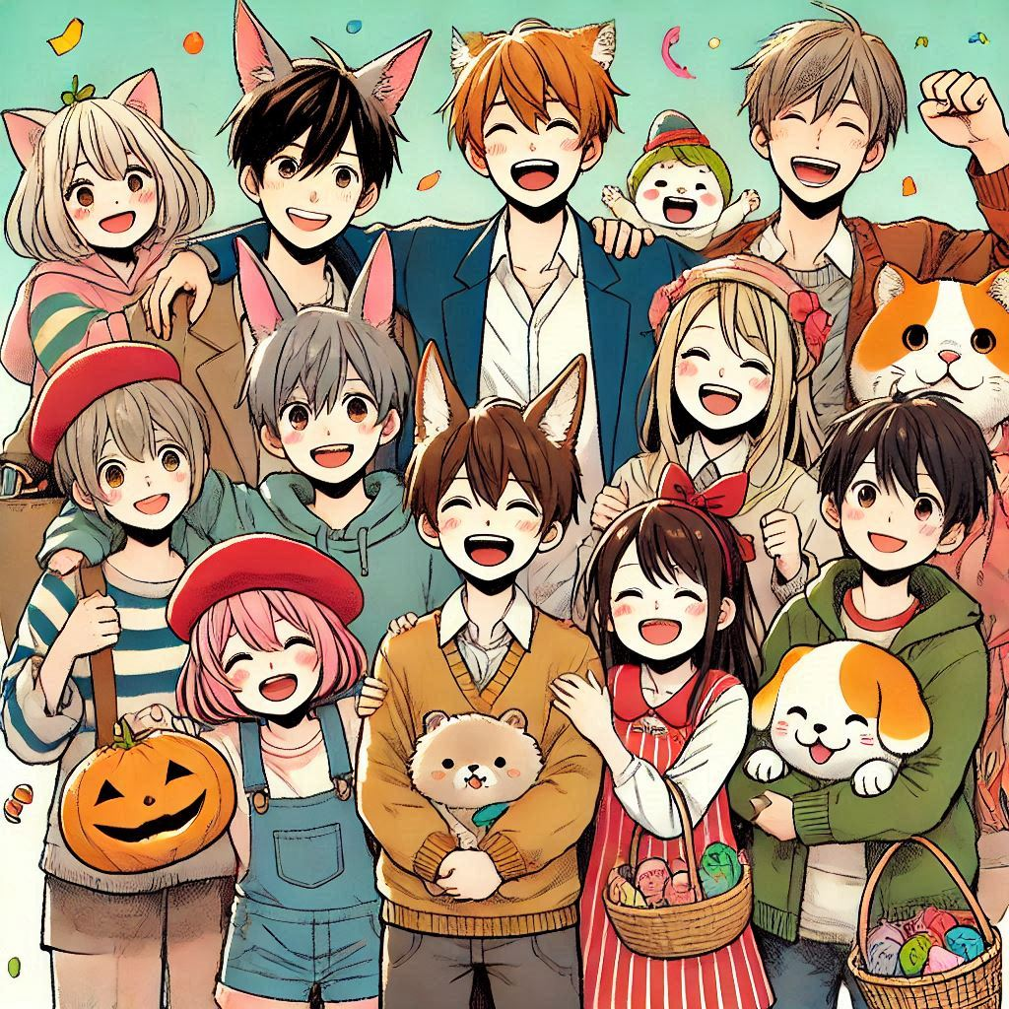
Ending
Notes:
a Japanese anime-style girl with two-toned hair (left side blue-green, right side white)

Slide 19
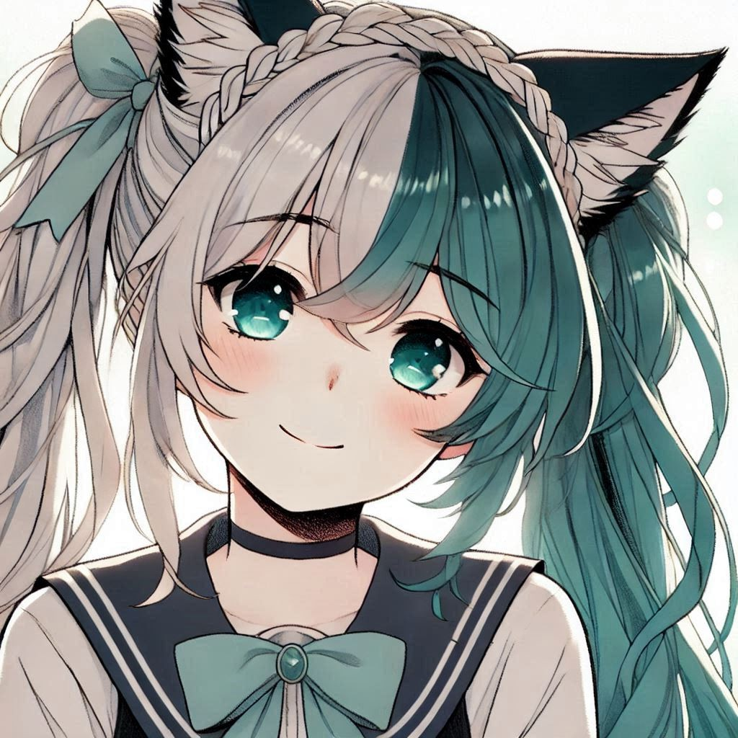
Ending
Notes:
a Japanese anime-style girl with two-toned hair (left side blue-green, right side white)

